Slide 1
Member Benefits and Welcome!
Kim McMahon
Director of Visibility and Community Engagement
RISC-V International

Slide 2
Sections
Latest RISC-V measures of progress
Benefits of Membership
Technical engagement
Visibility engagement
Navigating the community

Slide 3
Welcome!
Introductions
Tell us about your organization!
Company background
Your goals in joining RISC-V
Describe your work with RISC-V technologies

Slide 4







Meet the RISC-V Team
Calista Redmond
CEO
Mark Himelstein
CTO
Kim McMahon
Director of Marketing
Stephano Cetola – Technical Program Manager
Jeffrey “Jefro” Osier-Mixon – Program Manager
Megan Lehn
Program Manager
Jenni McGinnis
Program Manager

Slide 5
RISC-V
Measures of Progress

Slide 6
Welcome to the open era of computing.
RISC-V is the free and open Instruction Set Architecture…
Driven through open collaboration
Enabling freedom of design across all domains and industries
Cementing the strategic foundation of semiconductors

Slide 7
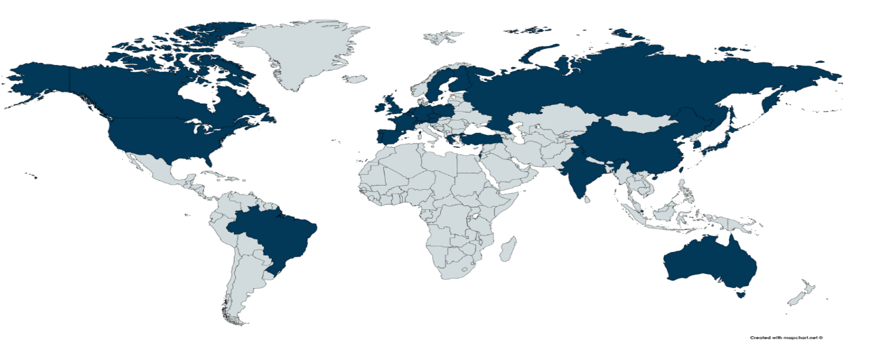
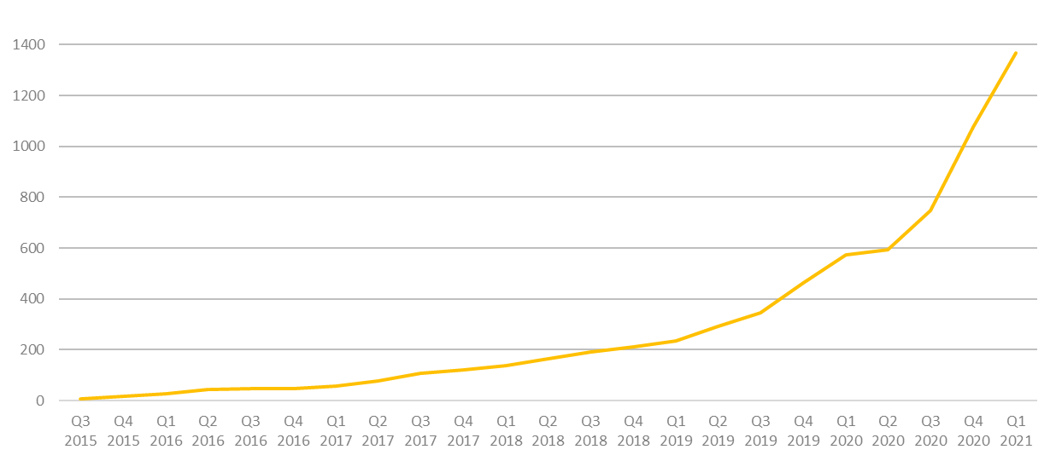
2k+ RISC-V Members
across 70 Countries
94 Chip SoC, IP, FPGA
4 I/O Memory, network, storage
12 Services Fab, design services
40 Software Dev tools, firmware, OS
4 Systems ODM, OEM
13 Industry Cloud, mobile, HPC, ML, automotive
81 Research Universities, Labs, other alliances
1,000+ Individuals
RISC-V engineers and advocates
In 2020, RISC-V membership grew 133%
December 2020

Slide 8
Industry innovation on RISC-V
Hardware
– RV64, multi-heart CPUs, vectors, bit manipulation, hypervisors, debug mode –
AI SoCs
Application processors
Software
Linux
Drivers
AI Compilers
Hardware
– RV32, privilege modes, interrupts –
IoT SoCs
Microcontrollers
Software
RTOS
Firmware
Hardware
– RV32 –
Proof of Concept SoCs
Minion processors for power management, communications, …
Software
Bare metal software
Hardware
ISA Definition
Test Chips
Software
Tests
Complexity
2010 – 2016
2017 – 2018
2019 – 2020
2021

Slide 9
Incredible industry progress
The European Processor Initiative finalized the first version of its RISC-V accelerator architecture and will deliver test chip in 2021.
The RIOS Lab announced PicoRio, an affordable RISC-V open source small-board computer available in 2021.
Imperas announced first RISC-V verification reference model with UVM encapsulation.
Seagate announced hard disk drive controller with high-performance RISC-V CPU.
GreenWaves ultra-low power GAP9 hearables platform enabling scene-aware and neural network-based noise reduction.
Alibaba unveiled RV64GCV core in its Xuantie 910 processor for cloud and edge servers.
Microchip released the first SoC FPGA development kit based on the RISC-V ISA.
Andes released superscalar multicore and L2 cache controller processors.
StarFive released the world’s first RISC-V AI visual processing platform
SiFive unveiled world’s fastest development board for RISC-V Personal Computers.
Micro Magic announced an incredibly fast 64-bit RISC-V core achieving 5GHz and 13,000 CoreMarks at 1.1V.
Notes:
The European Processor Initiative partners have finalized the first version of its RISC-V accelerator architecture, named EPAC, and are working towards the delivery of the first EPAC Test Chip in 2021. Link
The RISC-V International Open Source Laboratory (also known as RIOS Lab), announced the PicoRio open-source project. The PicoRio will be a RISC-V-based small-board computer available at an affordable price point, and will be available to ship in the first half of 2021. Link
Imperas announced the first reference model with UVM encapsulation for RISC-V verification.
Micro Magic announced the world’s fastest 64-bit RISC-V core achieving 5GHz and 13,000 CoreMarks at 1.1V.
Microchip released the industry’s first SoC FPGA development kit based on the RISC-V ISA.
Saifang Technology released the world’s first RISC-V AI visual processing platform-Jinghong 7100.
SiFive unveiled the world’s fastest RISC-V development board. The board is available for $665.

Slide 10
Membership
What it means and what you get!

Slide 11
Benefit of joining RISC-V
Accelerate technical traction and insight
Contribute technical priorities, approaches, and code
Gain strategic and technical advantage
Increase visibility, leadership, and market insight
Fill and increase engineering skills, retain and attract talent
Build innovation partner network and customer pipeline
Deepen, engage, and lead in local and industry developer network
Showcase RISC-V products, services, training, and resources

Slide 12

Membership Options
Premier Member Benefits
Community level benefits plus…
Use of RISC-V Trademark for commercialization
Board seat and Technical Steering Committee seat included for $250k level
Technical Steering Committee seat included for $100k level
Solution / Product listing highlighted on RISC-V Exchange
4 case studies a year
2 blogs per month
2 social media spotlights per month
Spotlight member profile
Inclusion in event promotions
Strategic Member Benefits
Community level benefits plus…
Use of RISC-V Trademark for commercialization
3 Board reps elected for Strategic tier, includes Premier members that do not otherwise have a board seat.
Eligible to lead workgroup and/or committee
Solution / Product listing highlighted on the RISC-V Exchange
1 case study a year
1 blog per month
1 social media spotlight per month
Community Member Benefits
Accelerated development, reduced risk through open source, ratified ISA.
Eligible to participate in workgroups, influence strategy and adoption
6 support programs in Technical Deliverables, Compliance, Visibility, Learning, Advocacy, and Marketplace
1 voting Academic Board rep, 1 non-voting Community Board rep
Member logo / name listing on RISC-V website, by member level
Event registration discount
Premier Requirements
Membership open to any type of legal entity
$250k Annual membership fee that includes Board seat and TSC seat
$100k Annual membership fee that includes TSC seat
Strategic Member Requirements
Membership open to any type of legal entity
Annual membership fee based on employee size
5,000+ employees: $35k
500-5,000 employees: $15k
<500 employees: $5k
<10 employees & company <2 yrs old: $2k
Community Requirements
Membership open to
academic institutions,
non-profits,
individuals not representing a legal entity
No annual membership fee

Slide 13
Technical engagement

Slide 14
Technical Working Groups
The technical groups are the heart of RISC-V. These groups create and maintain the hardware ISA and other items around it, including test and debug frameworks, software specs, and other technical artifacts. Visit our Working Groups page to find groups that fit your interests.

Slide 15
Group/Meeting Types & Responsibilities
Group | Responsibilities
Technical Steering Committee (TSC) | Delegation of responsibilities to organizational components below it, strategy, escalations, group & chair & preliminary charter approvals, ratification. voting (most discussion and notification by email, web page listing and supporting docs, automated voting system). The TSC has voting members and non-voting attendees. The voting members include premiers and HC and IC chairs. (non-voting attendees are advisors and RISC-V staff)
Chief Technology Office (CTO) | Runs TSC voting process, both Chairs meetings, Strategy, organization, IT, roadmap, resources, escalations,
ISA Committees (IC) | Approve and oversee package for TSC vote for the creation of ISA Extension TGs and filling the chair and vice-chair vacancies for its TGs. Develop strategy for the groups under it and complete coverage of areas of responsibility under it including gaps.
Horizontal Committees (HC) | Approve and oversee non-extension TGs, and has responsibilities to make sure that all Extension TGs cover the area overseen by the HC before ratification, Responsible for developing a holistic strategy and reaching out to the external ecoystem and community groups.
Horizontal Subcommittees (HSC) | It is a nested HC.
Task Groups (TG) | Must have charter that define deliverable work products: extension specifications, standards, requirements, best practices, etc.. TGs under the unpriv and priv SC can have ISA extension work products. TGs under HCs should not have ISA extension work products.
Special Interest Groups (SIG) | Topic discussion. No work product. Can be created by the TSC, ICs or HCs with TSC approval not required.
Meeting | Responsibilities
Committee Chairs Meeting | TSC strategy discussions. Invitees are TSC Voting members + overlapping IC chairs & HC chairs, RISC-V staff, and advisors and ad-hoc invitees.
Chairs Meeting | Invitees are RISC-V staff, Chairs & Vice Chairs of all ICs, HCs, HSCs, TGs, & SIGs. Policy approval, general governance, escalations, exceptions, final charter approval, voting as appropriate.

Slide 16
Horizontal
Technical Organization
Board of Directors (BoD)
Technical Steering Committee (TSC)
CTO, Staff
Architecture Profiles
Industry Verticals SIG
Unpriv IC
Priv IC
Software HC
(Platforms, Toolchains, Runtimes)
IMAFDQC
1.11
Memory Model
Security HC
B TG
1.12 (Priv)
RASD HC
V TG
VM TG
Technology HC
J TG
FastInt TG
SoC Infra. HC
(Trace & Debug)
P TG
CMO TG
Consumer
Defense/MilAero
Automotive
Data Center
Finance
Communications
Oil & Gas
TEE TG
Implementation HC
ZfinX TG
H TG
ISA Infrastructure HC
Code Size TG
Krypto TG
Alt FP TG
inception
dotted line
pending

Slide 17
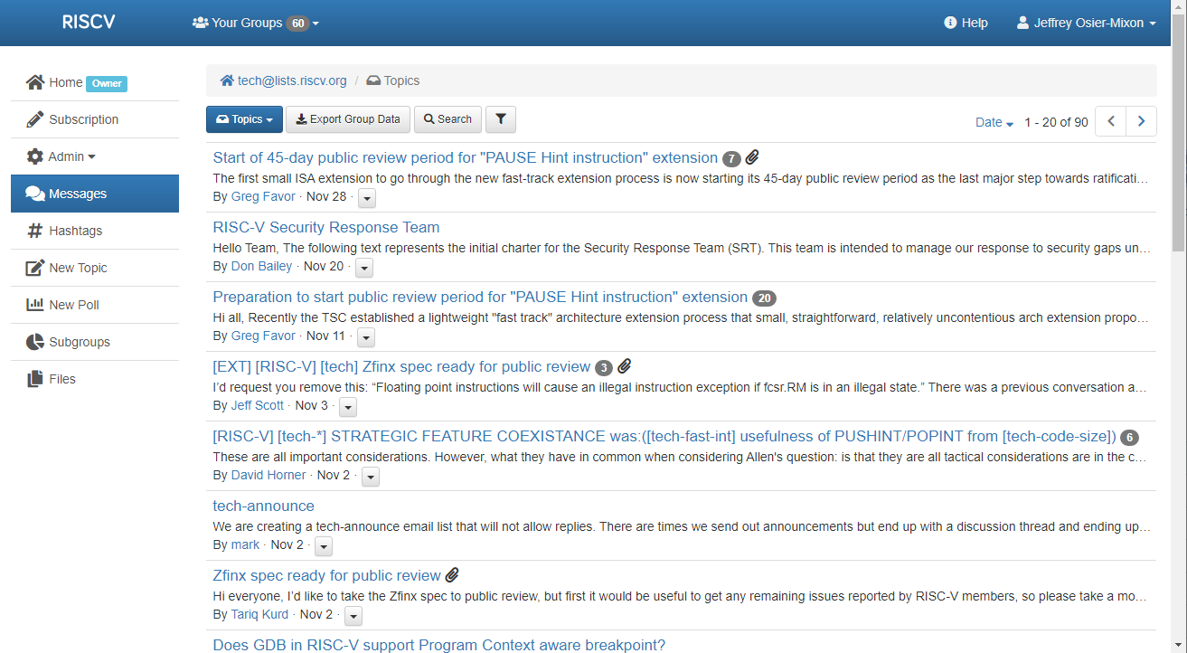
Member Portal - lists.riscv.org

Slide 18
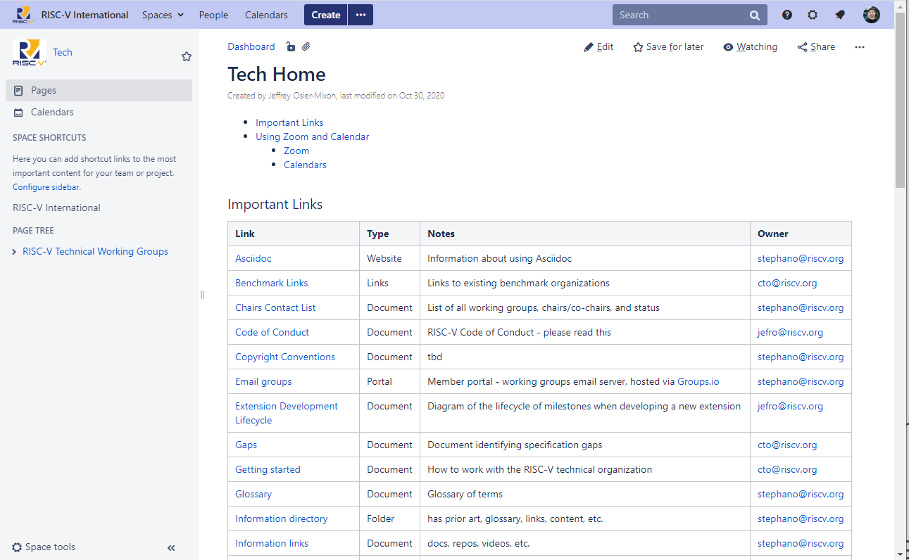
Tech Wiki - wiki.riscv.org

Slide 19
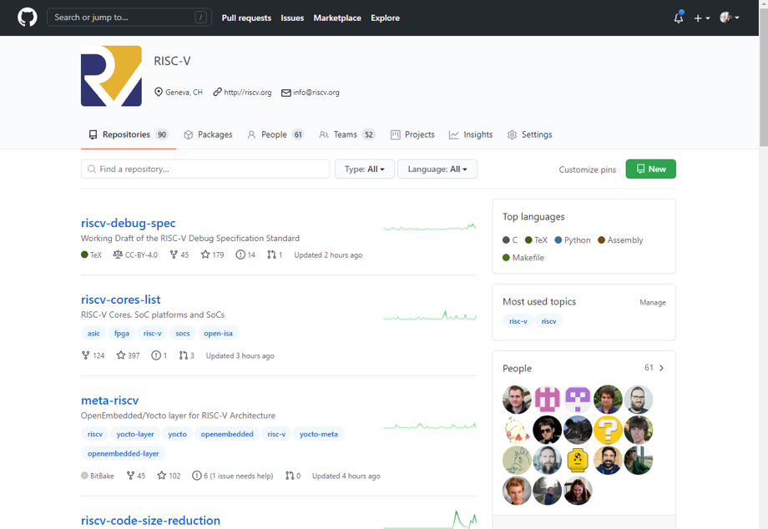
GitHub - github.com/riscv

Slide 20
Regular meetings
All Hands meetings
Quarterly summary, open to all members.
Technical Working Group meetings
Committees & task groups meet via Zoom, usually on 1-2 week cadence. All members are welcome to participate.
Technical Steering Committee (TSC) & Committee Chairs Meeting (CCM)
TSC = technical organization governance. TSC members only.
CCM = TSC strategy discussions. Invitees are: TSC members + IC chairs & HC chairs, RISC-V staff, advisors and ad-hoc invitees
Tech Chairs Meetings (TCM)
Policy approval, general governance, escalations, exceptions, final charter approval, voting as appropriate. Chairs & Vice Chairs of all ICs, HCs, HSCs, TGs, & SIGs, RISC-V staff.

Slide 21
Visibility engagement

Slide 22
Marketing Committee + Working Groups
Participate in the marketing committee to engage with your peers, learn about member marketing benefits, and contribute.
Marketing Committee
Primary communication tool with members on RISC-V marketing initiatives.
Meetings: 2nd Tuesday of the month, 8am PT (5pm CEST)
Marketing Content Task Group Discuss content topics such as website, exchange, and research.
Meetings: Last Tuesday of the month: 8am PT (5pm CEST)
Marketing Events Task Group
Discuss upcoming events and actions as well as event plans for future
Meetings: Every other Thursday: 9am PT (6pm CEST)

Slide 23
Events

Slide 24
RISC-V Events: Overview
RISC-V events are an important part of the overall marketing and awareness plan. Through our events, we are able to touch on many or our key themes and visibility priorities:
Pro-active media engagement and grow engagement with industry media and analysts
Highlight the adoption of RISC-V and in targeted industry verticals: Cloud, HPC, IoT, AI, Automotive
Demonstrate industry thought leadership
Engage with the developer community and highlight community leaders
Spread RISC-V learning to a broader audience
Grow alliances
Add value to RISC-V membership by offering opportunities for members to participate and engage with the community.
Amplify member product announcements and milestones
Drive new member acquisition

Slide 25
RISC-V Events: Who attends
Target Audience:
Chip design and manufacturers
Cloud / Hyperscale companies
Solution and testing providers in the area of chip development
Technical Management
Executive Leadership
Product Managers and Product Marketing
End-users
Industries:
IoT
IA
Sensor
Storage
Wireless
Automotive
Industrial automation
Aerospace
Job Titles from last year’s roadshows
C-Suite: CEO, CTO
Vice President, Senior Technologist, Principle Engineer, Technical Staff
Design Engineering Manager, System Software Architect
Engineer: R&D, Embedded, System, Applications, FPGA, SW Design & Development, Security Design, Test
Developer: FPGA, Embedded software, SOC Design,
Product Marketing, Sales, Marketing

Slide 26
RISC-V event types
RISC-V Hosted & Supported
RISC-V Regional
Industry
Community
RISC-V hosted events.
Our flagship Summit events in Europe, China, and North America.
RISC-V Forums such as single-topic webinars, workshops, and roadshows.
RISC-V Days <city>
Events are organized and held by our regional RISC-V alliances.
RISC-V supported and promoted.
Events that focus on technology, industry verticals, and open source.
The goal is for RISC-V to be represented across a variety of relevant technical and industry events.
Organized by RISC-V Ambassadors and community members.
These local events bring together the community for learning.

Slide 27


RISC-V Hosted & Supported Events
RISC-V Summit
RISC-V Forums
RISC-V Days
Our flagship events held in 3 geographies:
Europe: Spring
China: Summer
North America: Winter
Formats:
RISC-V organized
Keynotes, multiple tracks, networking
Sponsorships to cover costs
Smaller virtual or regional events focused heavily on RISC-V technologies and learning.
Formats:
RISC-V organized
Short-form, single-topic webinars
Workshops
Roadshows
Hands-on learning events
Sponsorships to cover costs
Regional events organized by the community.
RISC-V supported and promoted.
Formats:
RISC-V Day <city>
Keynotes, multiple tracks, networking
Organized, managed, and paid for by the community
RISC-V supported

Slide 28



Upcoming Forums
Short-form, single-topic events
Schedule Announced
Register!
Currently Registered - 220
Sponsored By
June 2
16:00 - 19:00 CEST
CFP and Registration Open May 17
Sponsored By
July 21
8:00 - 11:00
China Standard Time

Slide 29
RISC-V Days India
Date(s): July 9-10
Location: Chennai – India
Format: Online and In-Person
Keynote, Invited Talk, and Plenary
Themes: Security, Fault Tolerance, AI / ML, Architecture, Products
Host: Jointly Organised by IIT Madras, RISC V International, and IITM Pravartak Technologies Foundation
Additional Information:
CFP: Opening April 5
Sponsorships: Email for information
For additional information, email
On hold

Slide 30
RISC-V World Conference China
Date(s): June 22 - 24
With 5~8 co-located workshops, tutorials, and seminars
Location: ShanghaiTech University, Shanghai, China
Format: Online + in-person
In-person: 1,000 ~ 2,000
Online: more than 10,000
Booths: 50~80
Host: RISC-V
ISCAS and ShanghaiTech as co-host; CRVIC and CRVA, CNRV as co-organizers
Additional Information:
Sponsorships: 5 Diamond are sold out; 2 gold, 3 silver, and several bronze are available. Interested - email china@riscv.org
For additional information, email china@riscv.org

Slide 31
Non-RISC-V Events

Slide 32
Tier 1 Events 2021
Major event. RISC-V investment. Goal is to recover costs through sponsorships.
Tier 1 Events | Conference Date(s) | RISC-V Session Dates | Location | Tier | CFP Due Date | Schedule announce
ISC High Performance | June 24 - July 2 | 6/24/2021 | Virtual | 1 |  | Program
SC21 | November 14 - 19 | 11/14/2021 | St. Louis | 1 | Multiple
Design Automation Conference DAC | December 5 - 9 | 12/5/2021 | San Francisco | 1 | January 20

Slide 33
Tier 2 Events 2021
RISC-V sponsored events. Members are encouraged to participate through their own sponsorships, presentations, and promotion of RISC-V activities.
Tier 2 Events | Conference Date(s) | RISC-V Session Dates | Location | Tier | CFP Due Date | Schedule announce
Zephyr Developer Summit |  | 6/8/2021 |  | 2 | April 20
LF Open Source Summit | Sept 28 - Oct 1 | 9/28/2021 | Seattle | 2 | June 13 | July 29
Embedded Tech Conference | June 22 - 24 | 6/22/2021 | San Jose | 2
HotChips 33 2021 | August 22 - 24 | 8/22/2021 | TBD | 2 | CFP
RISC-V Day Taipei | Sep 2021 |  | Taiwan | 2
AI Hardware Summit | Sept 14-16 | 9/14/2021 | Mountain View | 2
Linux Plumbers | Sept 27 - 29 | 9/27/2021 | Dublin | 2
Linux Foundation Member Summit | Nov 2 - 4 | 11/2/2021 | Napa | 2 | N/A
Open Source Summit China | Dec 2021 |  |  | 2
RISC-V Day Vietnam | Sep 2021 |  | Japan | 2
RISC-V Day Tokyo | Nov 2021 |  | Japan | 2
Automotive Linux Summit | Winter 2021 |  | Tokyo | 2

Slide 34
Tier 3 Events 2021
RISC-V will not be sponsoring. Members are encouraged to participate through their own sponsorships, presentations, and promotion of RISC-V activities.
KubeCon + CloudNativeCon Europe 2021 | May 4-7 | 5/4/2021 | Virtual | 3 |  | Schedule
RISC-V Con |  | 5/28/2021 | Virtual | 3
International Conference on Supercomputing 2021 | Jun 14-17 | 6/14/2021 | Virtual | 3 |  | Program
Workshop on Computer Architecture Research with RISC-V (CARRV) |  | 6/17/2021 | Virtual | 3 | May 7
Hardwear.io USA 2021 | July 9-10 | 7/9/2021 | Virtual | 3 | May 15
FPGA Conference Europe | July 6 - 8 | 7/6/2021 | Munich | 3 | March 18
Supercomputing Frontiers 2021 |  | 7/19/2021 | Virtual | 3 | May 16
3D & Systems Summit | Sep 1-3 | 9/1/2021 | Virtual | 3
Computex Taipei 2021 | June 1-4 | 6/1/2021 | Virtual | 3
Flash Memory Summit | Aug 4-6 | 8/4/2021 | Santa Clara | 3
IEEE Host Symposium | Dec 5 - 8 | 12/5/2021 | Washington DC | 3 | April 27
Hyperledger Global Forum | June 8 - 10 | June 8-10 | Virtual | 3 | March 12 | April 15

Slide 35
Pending Events 2021
More information is needed about the event (date, location, CFP, etc.) before moving to a tier
Pending Events | Conference Date(s) | RISC-V Session Dates | Location | Tier | CFP Due Date | Schedule announce
Grace Hopper | Sept 26 - 29 | 9/26/2021 | Virtual | Pending | April 2021 | June 2021
LF Open Source Leadership Summit China | 1H 2021 |  | China | Pending
Open Core Summit | 2H 2020 |  | US | Pending
edacentrum workshop | 2H 2020 |  | US | Pending
Hardwear.io | 2H 2020 |  | US | Pending
World Internet Conference | Nov 2021 |  |  | Pending
European Processor Initiative |  |  |  | Pending

Slide 36
Marketing and Visibility benefits
Share your products and progress with RISC-V!

Slide 37


RISC-V Events
Participating with RISC-V in industry events
Shows your support for open source and RISC-V
Opportunity to demonstrate your knowledge and leadership to the community
Demo your products and collect leads

Slide 38

RISC-V Blog
The RISC-V blog program is a great way to showcase leadership and industry commentary, as well as share technical information on your work with RISC-V.
Members can submit content to publish on riscv.org and we promote on social, as well as a link to the member website to drive traffic.

Slide 39
Case Studies
Case studies help elevate the technical conversations to business objectives and challenges, showing the use and adoption of RISC-V across multiple industries and use cases.
As a member, we will publish your case study!
Case studies will be highlighted on our website and shared via our wide-reaching media channels and analyst relationships.

Slide 40
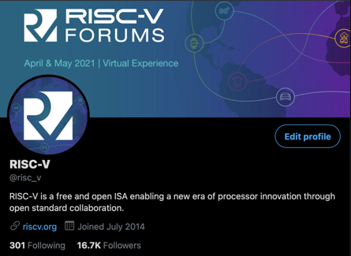

Content - Social
RISC-V is happy to share community, member, and Ambassador content via our social channels!
Members can submit original content for our posting on our social channels
Members and the community can submit content for re-sharing.

Slide 41

Press and Analysts
Share member and community news “In the News”
Highlight member announcements via social
Provide RISC-V team member quotes for member press releases
Options to submit member news and announcements and participate in media panels.

Slide 42





Branding
As a member, use RISC-V branding in your marketing materials!
Branding Guidelines and logos

Slide 43
Navigating the community

Slide 44
Marketing Committee + Working Groups
Participate in the marketing committee to engage with your peers, learn about member marketing benefits, and contribute.
Marketing Committee
Primary communication tool with members on RISC-V marketing initiatives.
Meetings: 2nd Tuesday of the month, 8am PT (5pm CEST)
Marketing Content Committee Discuss content topics such as website, exchange, and research.
Meetings: Last Tuesday of the month: 8am PT (5pm CEST)
Marketing Events Committee
Discuss upcoming events and actions as well as event plans for future
Meetings: Every other Thursday: 9am PT (6pm CEST)

Slide 45
Technical Working Groups
The technical groups are the heart of RISC-V. These groups create and maintain the hardware ISA and other items around it, including test and debug frameworks, software specs, and other technical artifacts. Visit our Working Groups page to find groups that fit your interests.

Slide 46
Group/Meeting Types & Responsibilities
Group | Responsibilities
Technical Steering Committee (TSC) | Delegation of responsibilities to organizational components below it, strategy, escalations, group & chair & preliminary charter approvals, ratification. voting (most discussion and notification by email, web page listing and supporting docs, automated voting system). The TSC has voting members and non-voting attendees. The voting members include premiers and HC and IC chairs. (non-voting attendees are advisors and RISC-V staff -- no organization can be represented more than once)
Chief Technology Office (CTO) | Runs TSC voting process, both Chairs meetings, Strategy, organization, IT, roadmap, resources, escalations,
ISA Committees (IC) | Approve and oversee package for TSC vote for the creation of ISA Extension TGs and filling the chair and vice-chair vacancies for its TGs. Develop strategy for the groups under it and complete coverage of areas of responsibility under it including gaps.
Horizontal Committees (HC) | Approve and oversee non-extension TGs, and has responsibilities to make sure that all Extension TGs cover the area overseen by the HC before ratification, Responsible for developing a holistic strategy and reaching out to the external ecoystem and community groups.
Horizontal Subcommittees (HSC) | It is a nested HC.
Task Groups (TG) | Must have charter that define deliverable work products: extension specifications, standards, requirements, best practices, etc.. TGs under the unpriv and priv SC can have ISA extension work products. TGs under HCs should not have ISA extension work products.
Special Interest Groups (SIG) | Topic discussion. No work product. Can be created by the TSC, ICs or HCs with TSC approval not required.
Meeting | Responsibilities
Committee Chairs Meeting | TSC strategy discussions. Invitees are IC chairs & HC chairs, RISC-V staff, TSC, and advisors and ad-hoc invitees.
Chairs Meeting | Invitees are RISC-V staff, Chairs & Vice Chairs of all ICs, HCs, HSCs, TGs, & SIGs. Policy approval, general governance, escalations, exceptions, final charter approval, voting as appropriate.

Slide 47
Horizontal
Technical Organization
Board of Directors (BoD)
Technical Steering Committee (TSC)
CTO, Staff
Architecture Profiles
Industry Verticals SIG
Unpriv IC
Priv IC
Software HC
(Platforms, Toolchains, Runtimes)
IMAFDQC
1.11
Memory Model
Security HC
B TG
1.12 (Priv)
RASD HC
V TG
VM TG
Technology HC
J TG
FastInt TG
SoC Infra. HC
(Trace & Debug)
P TG
CMO TG
Consumer
Defense/MilAero
Automotive
Data Center
Finance
Communications
Oil & Gas
TEE TG
Implementation HC
ZfinX TG
H TG
ISA Infrastructure HC
Code Size TG
Krypto TG
Alt FP TG
O&CR
inception
dotted line
pending

Slide 48
Software HC
AI/ML/NLP SIG
Platform HSC
Toolchain & Runtime HSC
Android SIG
Linux class OSs
RTOSs
DMA
Multi-processing
Hypervisors
JITs
IOMMU, Buses
Bootloaders
Distro coordination/build/rel
*BIs
Config TG
EABI TG
DB/App
Performance modeling tools SIG
Code Optimization SIG
SW Hypervisor SIG
Code Size TG
Benchmarks
Regression test strategy
Ecosystem changes
Extensions needed
Worst Case Execution Time (WCET)
Spatial & Timing interference
Advanced Interrupt Architecture (AIA) TG
psABI TG
Overlays TG
HPC SIG
Managed Runtimes SIG
Performance analysis tools SIG
Native code
GCC
LLVM
Optimizer
Profiler
gdb
inception
Graphics SIG
dotted line
pending

Slide 49
SOC Infrastructure HC
Security HC
Recoverability, Availability, Serviceability Dependability (RASD) HC
ISA Infrastructure
HC
(oversight & acceptance)
Implementation HC
Technology HC
Debug & Trace HSC
Security Response SIG
E2E Data Integrity
Diagnosability
Recoverability
Error Recording
Error reporting
Error isolation
Data poisoning containment
PCIe error reporting
Formal Specification TG
Power
Complexity
ROI
HW viability
SW viability
Early (kickoff)
Guidelines doc
POC
Simulators
Cost/Benefit
HPC SIG
E-Trace Code
Compliance TG
Blockchain SIG
Embedded SIG
Debug 0.1X
Crypto TG
Architecture tests SIG
Code Size TG
E-Trace instruction TG
TEE TG
Simulators
Debug TG revision
EABI TG
E-Trace data TG
Functional Safety SIG
Documentation
P TG
Nexus TG
CI/Testing
FastInt TG
IOMMU
Platform Interrupts
Power Management Infrastructure
Devops
Debug TG (for standalone)
Datacenter SIG
Communications SIG
dotted line
pending

Slide 50
Special Interest Groups (SIGs)
The SIGs have conversations and drive requirements in key industry and technology areas.
SIG Academia and Training
Coordinate outreach to the open source community as well as researchers and educators in academia, and to curate and recommend training materials to both academics and professional training organizations.
Meetings: Every other Thursday: 8am PT (5pm CEST)
SIG High Performance Computing (HPC)
Meetings: Monthly on 3rd Thurs: 4pm PT
SIG Functional Safety
Meetings: Every other Thursday: 8am PT (5pm CEST)
SIG Soft CPU

Slide 51


















RISC-V Alliances
RISC-V regional and industry alliances provide events, maintain relationships, and create multiple feedback channels in a way that no single organization could do on its own. See our alliances page for the full listing.
Regional Alliances
Communicate locally, provide local events, and maintain relationships in a way that no single organization could do on its own.
Industry Alliances
industry alliances create multiple feedback channels on both technical and non-technical topics that help both the RISC-V community and the industries using the RISC-V technology.

Slide 52
RISC-V Learn
Learning RISC-V is a challenging, highly rewarding activity. There are many resources available to help you on this technical journey, and we welcome new additions to these resources – please contact us at info@riscv.org with any questions or comments.
The Training Partner Program puts you in touch with global organizations who provide professional training.
There are several books on RISC-V available.
The Educational Materials list is a collection of open curricula from academic institutions around the world, in several languages.
Google Scholar provides an extensive and growing list of academic publications related to RISC-V

Slide 53







RISC-V Training Partners
RISC-V Training Partners are focusing on RISC-V training in a professional setting. The Training Partner Program extends the breadth and reach of RISC-V knowledge, providing opportunities for a broader audience to learn. See our Training Partner page for more information on our training partners or how to become a RISC-V Training Partner.

Slide 54
RISC-V Exchange
The RISC-V Exchange provides a window into work that people have accomplished around the world in the RISC-V community, including physical hardware, IP cores, and a great deal of software.
Available Boards
Available Cores & SoCs
Available Software
Contact us if you have a product to add to the Exchange.

Slide 55
RISC-V Ambassador Program
RISC-V Ambassadors are individuals passionate about RISC-V and dedicated to growing and engaging the RISC-V community.
Ambassadors are RISC-V experts and work together with RISC-V to ensure our global momentum and adoption. Successful ambassadors include engineers, developers, bloggers, influencers, evangelists who are already engaged with RISC-V in some way, including contributing to work groups, online groups, community events, training, workshops, and more.
The RISC-V Ambassador Program empowers community members with tools and resources to:
Promote RISC-V projects and technology
Educate a local community on the RISC-V mission and technical aspects
Engage RISC-V member participation and community growth
Requirements to be an official RISC-V Ambassador:
Organizational Member of RISC-V International
Already engaged with RISC-V as a contributor, blogger, speaker, etc.
Willing to speak on RISC-V topics at events
Contribute technical content such as blog post, video tutorial, training module, etc.
Host or speak at local RISC-V events
Learn more

Slide 56
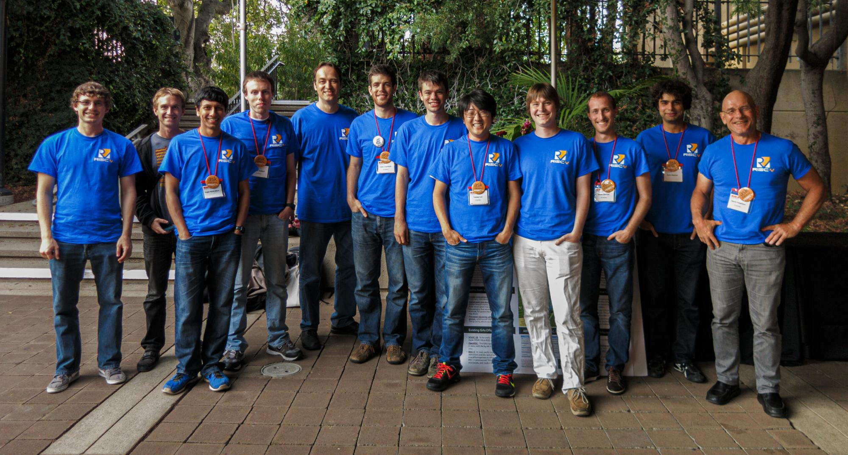
Build RISC-V into your company strategy, and your personal mission
RISC-V is a community of passionate, dedicated, and invested stakeholders
As individuals
As companies
As universities
As public institutions and non-profits
As nations
As one Global, connected movement

Slide 57
Thank you
Questions: info@riscv.org

Slide 58
RISC-V Color Palette
#ffc72c
#011e41
#0a6b7c
#cb007b
#60269e
#fdda64
#0a3799
#62cbc9
#fe9bb1
#c2a6e1

Slide 59
Gradient Elements
Gradient Background
Overlay Gradient

